Slide 1

Modern Control Theory
Lecture No. 25
Understanding the Implementation Methodology of a Kalman Filter for Filtering & Estimating States of a Process Equipment

Slide 2

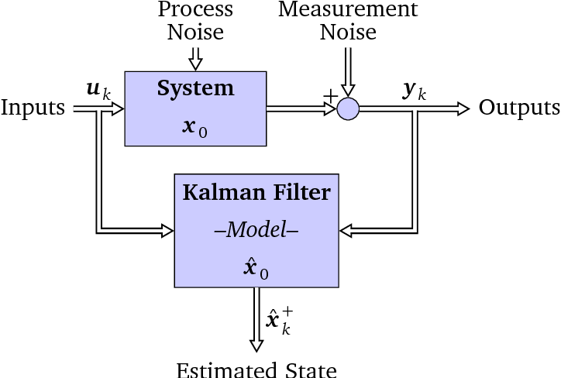
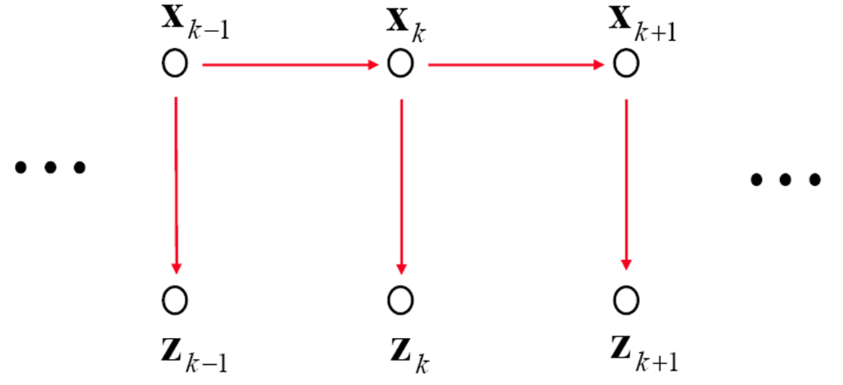

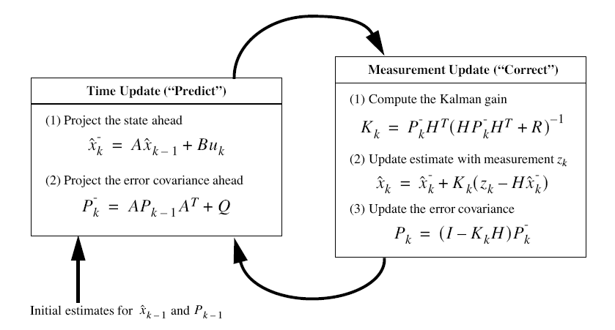
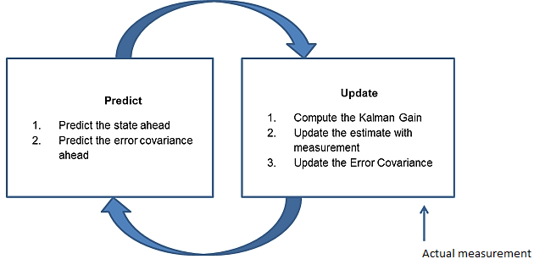
Recap --- Kalman Filter --- Prediction & Update

Slide 3
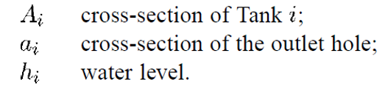
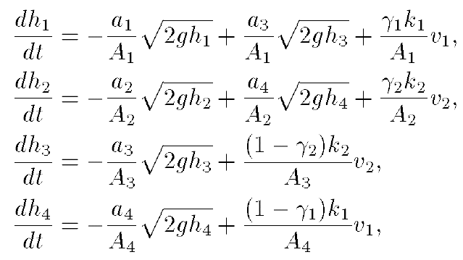
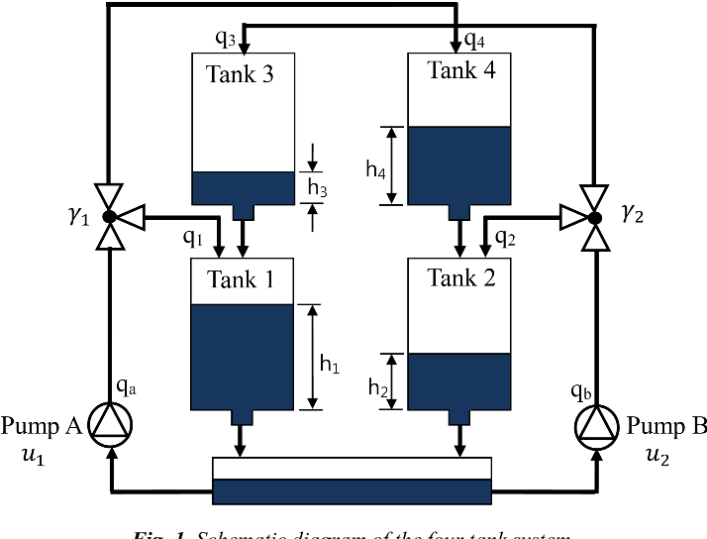
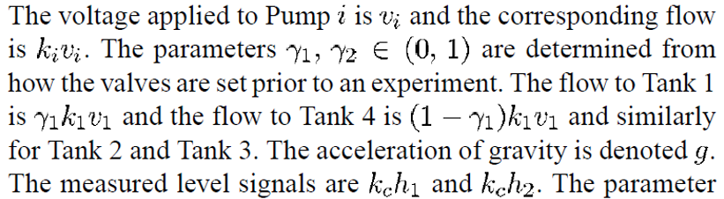
The 4-Tank Problem

Slide 4
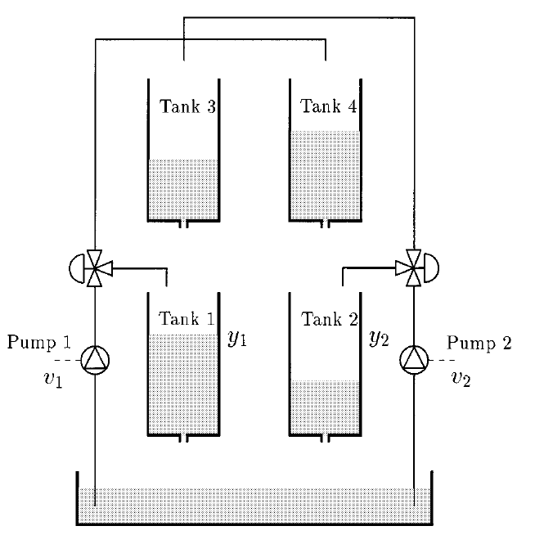
The 4-Tank Problem

Slide 5
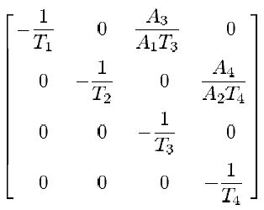
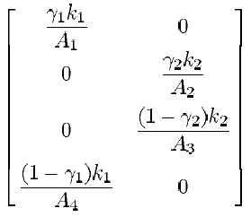
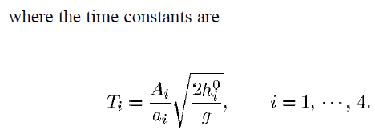

Linearized State Eqn. & Meas. Eqn.
A =
B =
Compute A, B, C, Matrices, based on data provided, viz. the details of the tank size, area of orifice, voltage applied to pump, etc.
Arrive at value for process/state noise, Q and Measurement Noise, R
The water level in the tanks,
h1, h2, h3, h4, are considered as states, [x] is the state vector
H =

Slide 6
A = [a11 a12 a13 a14; a21 a22 a23 a24; a31 a32 a33 a34; a41 a42 a43 a44]
B = [b11 b12; b21 b22; b31 b32; b41 b42 ]
H = [h11 h12 h13 h14; h21 h22 h23 h24]

Slide 7
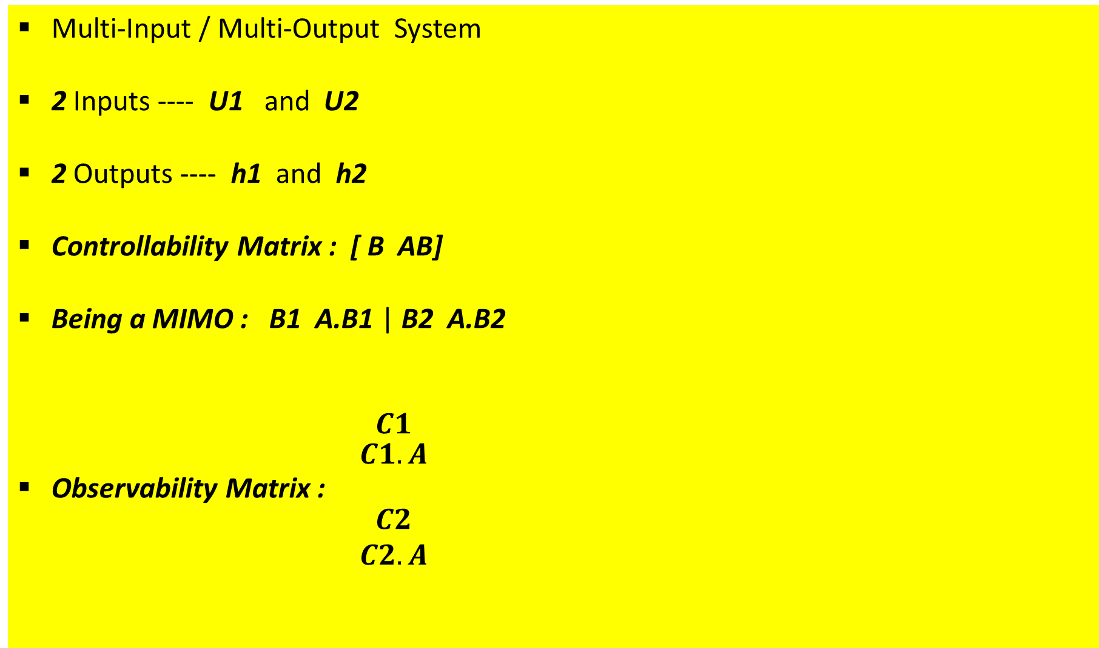
Multi-Input / Multi-Output System
2 Inputs ---- U1 and U2
2 Outputs ---- h1 and h2
Controllability Matrix : [ B AB]
Being a MIMO : B1 A.B1 | B2 A.B2
Observability Matrix : $\begin{matrix}C1 \\ \begin{aligned}C1.A \\ \end{aligned} \\ \begin{aligned}C2 \\ C2.A\end{aligned}\end{matrix}$

Slide 8
Kalman Filter Implementation
X_0 = [1 1 1 1]^T = X_post [0]
P_0 = 10^5 * eye(4) = P_post [0]
Q = 10 * eye(4); R = 2 * eye(2)
X_pri [k] = A * X_post [k-1] + B * [u [k-1]]
P_pri [k] = A* P_post [k-1] * A_tr + Q
K [k] = P_pri [k] * H_tr [k] * Inv [ H [k] * P_pri [k] * H_tr [k] + R ]
Z_est [k] = H [k] * X_pri [k]
E [k] = [Z_true [k] - Z_est [k] ]
X_post [k] = X_pri [k] + K [k] * E [k]
P_post [k] = P_pri [k] - K [k] * H [k] * P_pri [k]

Slide 9
Plot (X_post_store, k);
Plot (X_pri_store, k);
Plot (P_post_store, k);
Plot (P_pri_store, k);
Plot (P_pri_store, P_post_store, k);
Plot (K_store, k);
Plot (Innov_store, k);
Plot (Resid_store, k)
Understanding the Performance through Plots

